Slide 1
Set
A set is an unordered collection of items. Every set element is unique (no duplicates)
A Set is an unordered collection data type that is iterable, mutable and has no duplicate elements.
The major advantage of using a set, as opposed to a list, is that it has a highly optimized method for checking whether a specific element is contained in the set. This is based on a data structure known as a hash table.
A set doesn't store duplicate objects. Even if an object is added more than once inside the curly brackets, only one copy is held in the set object. Hence, indexing and slicing operations cannot be done on a set object.
The set is a Python implementation of the set in Mathematics. A set object has suitable methods to perform mathematical set operations like union, intersection, difference, etc.

Slide 2
Frozenset
Frozenset is a new class that has the characteristics of a set, but its elements cannot be changed once assigned. While tuples are immutable lists, frozensets are immutable sets.

Slide 3
bool
The truth values of an expression is stored as a python data type called bool. There are only two such values in this data type. True and False.
You can evaluate any expression in Python, and get one of two answers, True or False.
When you compare two values, the expression is evaluated and Python returns the Boolean answer:
print(10 > 9)
print(10 == 9)
print(10 < 9)
Almost any value is evaluated to True if it has some sort of content.
Any string is True, except empty strings.
Any number is True, except 0.
Any list, tuple, set, and dictionary are True, except empty ones.

Slide 4
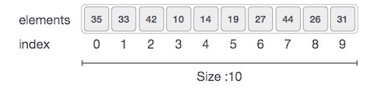
Python - Arrays
Array is a container which can hold a fix number of items and these items should be of the same type.
Element− Each item stored in an array is called an element.
Index − Each location of an element in an array has a numerical index, which is used to identify the element.
Array is created in Python by importing array module to the python program. Then the array is declared as shown below.

Slide 5
Basic Operations
Traverse − print all the array elements one by one.
Insertion − Adds an element at the given index.
Deletion − Deletes an element at the given index.
Search − Searches an element using the given index or by the value.
Update − Updates an element at the given index.

Slide 6
To create an array of numeric values, we need to import the array module. For example:
from array import *
arrayName = array(typecode, [Initializers])
import array as arr
a = arr.array('d', [1.1, 3.5, 4.5])
print(a)

Slide 7
In Python, we can treat lists as arrays. However, we cannot constrain the type of elements stored in a list. For example:
a = [1, 3.5, "Hello"]
#If you create arrays using the array module, all elements of the array must be of the same numeric type.
Lists are much more flexible than arrays. They can store elements of different data types including strings. And, if you need to do mathematical computation on arrays and matrices, you are much better off using something like NumPy.

Slide 8
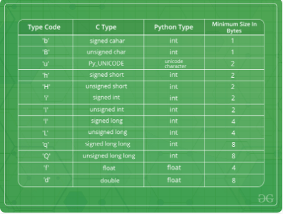
Typecode are the codes that are used to define the type of value the array will hold. Some common typecodes used are:

